Slide 1

Tech Club Audition Projects
Made By : Dhyey Dave
Class : 10K

Slide 2

Introduction To The Password Creator Program
This program helps the user to create randomized and strong passwords to help prevent them from getting hacked.
This program first asks how many passwords does the user want to create for different purposes.
After entering the number of passwords, the program asks the user to enter how many letters he/she wants to have in each password.
After entering that the program generates all the given number of passwords and that too, strong passwords!
This program may be useful to keep yourself safe from hackers by using strong passwords

Slide 3
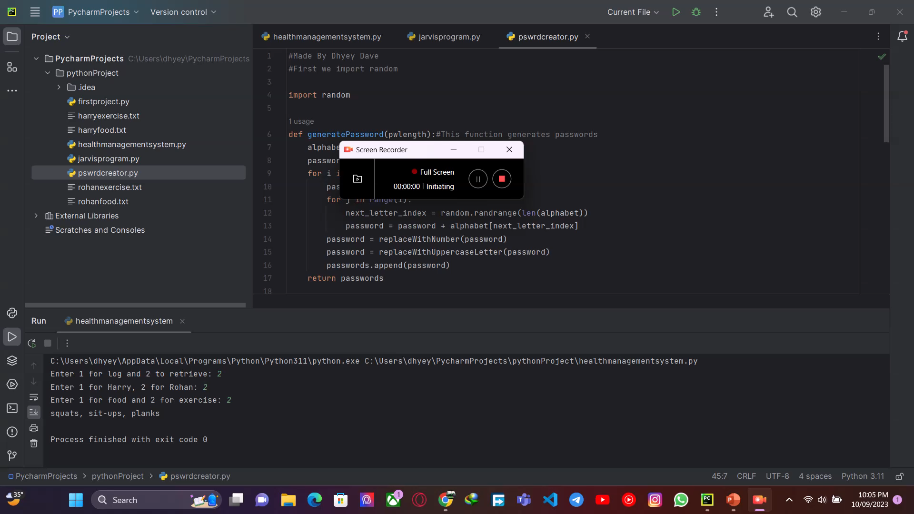
Video Showing The Password Creator Program

Slide 4

Introduction to The HIBPAPI Program
This is a program which uses the Have I Been Pwned API (HIBPAPI hence the name).
This program first asks you to enter your password and then checks if it has been found in any online breach.
If it is found in any online breach, then it shows the number of times it has been found in a breach.
If it very strong and hasn’t appeared in any of the online breach, then the program says that your password is safe.
This is very useful since it helps you find out whether the password you use is safe or hackers already know it!

Slide 5
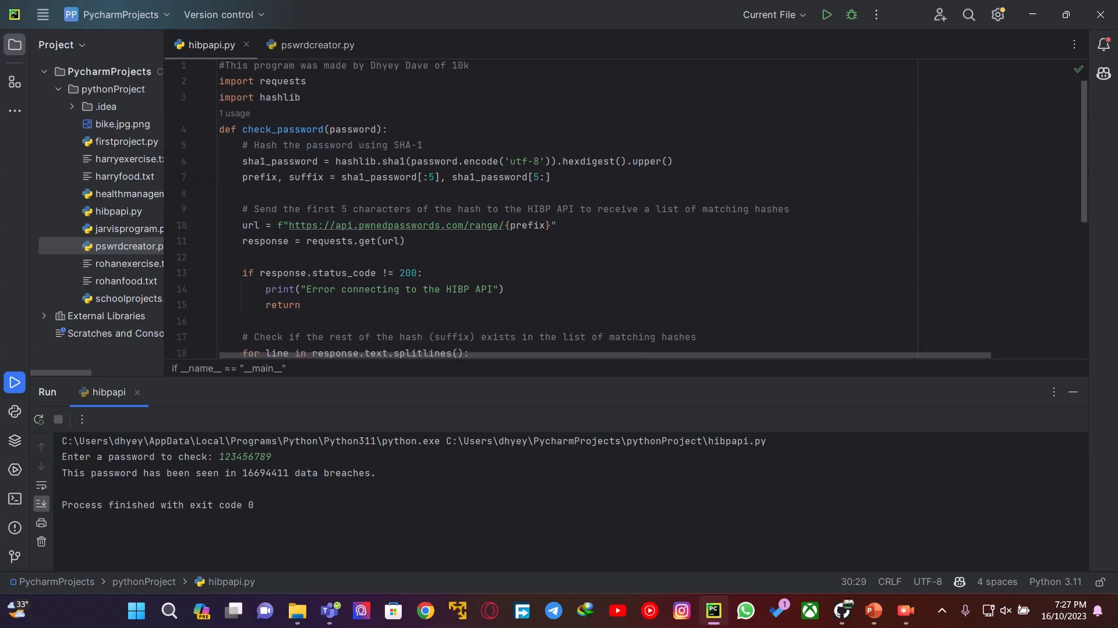
Video Showing The HIBPAPI Program

